Slide 1
Task 1 Report

Slide 2
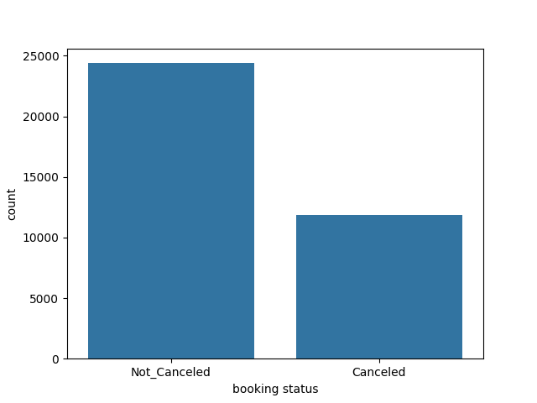
Class Distribution
We begin by calculating the distribution of our Label to check for class imbalance.
As shown in the plot, the Not_Cancelled class occurs a lot more than the Cancelled class, showing that most customers don’t cancel their reservations, however, there’s an imbalance.

Slide 3
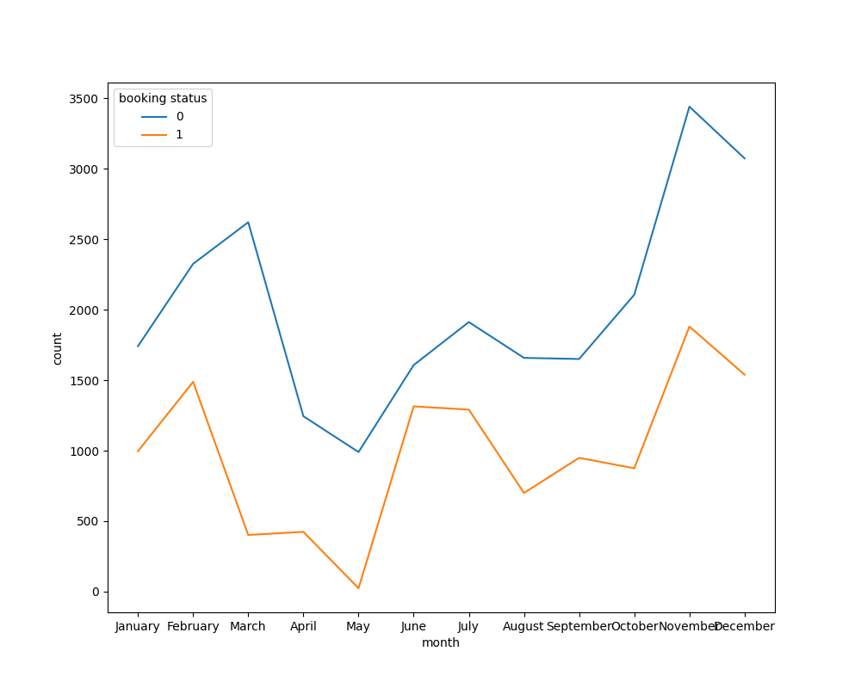
Class Occurrences throughout Time
After checking the ratio of Class occurrences, we want To visualize how they Change and differ throughout the year.
The graph shows that both values follow the same pattern, with the lowest point being in May and the highest between November and December

Slide 4
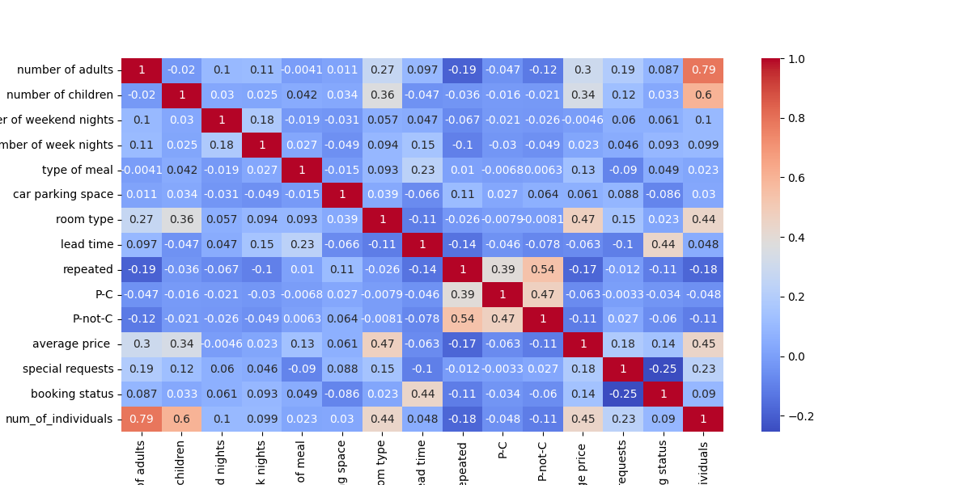

Slide 5
Heat Map
In the previous slide a heat map is shown that demonstrates the correlation levels between the features and each other.
The analysis shows multiple features with high correlation that will need to be represented separately for accurate comparison using other plots

Slide 6
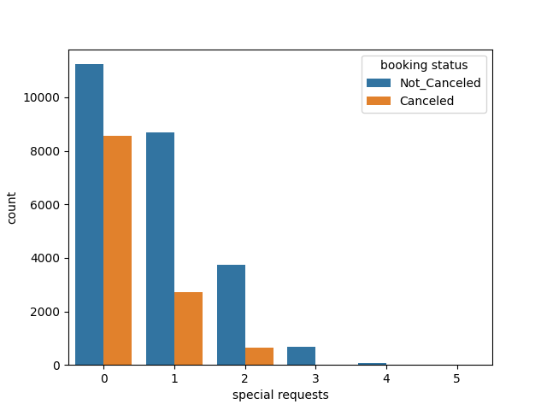
Special Requests and Label Relationship
The heatmap showed that special requests and the booking status had a weak negative relationship.
This can be confirmed from this count plot that shows that the more special requests are made, the less bookings are made.

Slide 7
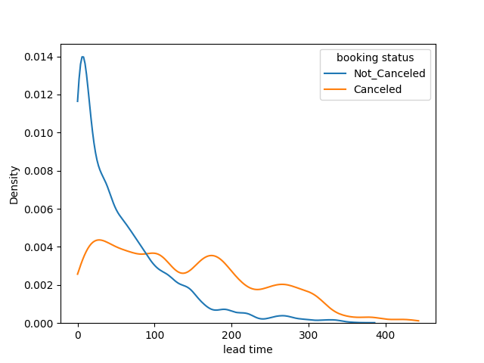
Lead Time and Label Relationship
The heatmap showed that lead time and booking status had a weak negative correlation.
From this KDE plot, this can be confirmed as both cases of booking status of being cancelled and not cancelled decrease as the lead time increases.

Slide 8
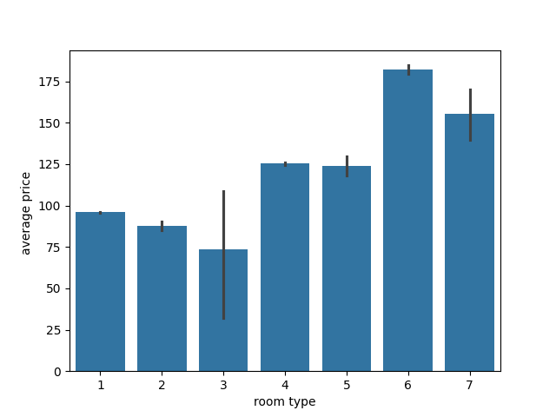
Room type and Average Price
In this bar plot, it is confirmed that as the room type increases, the average price increases as well.
The exception in this case being room 7, which is possibly due to fewer data points on reservation with room 7

Slide 9
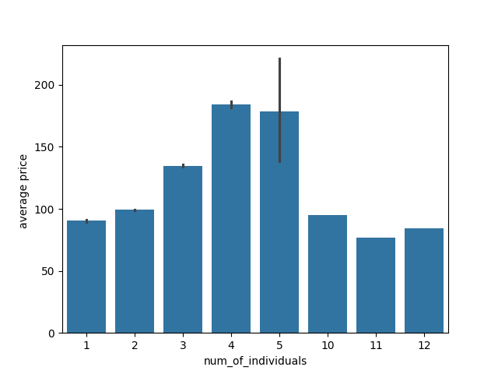
Average Price and Number of Individuals
This bar plot confirms that average price also has a direct relationship with the number of individuals, which is similar to its relationship with the room type.
The drop that happens when the number of individuals is more than 4, is due to having very few data points on the cases of 5, 10, 11, 12 individuals.

Slide 10
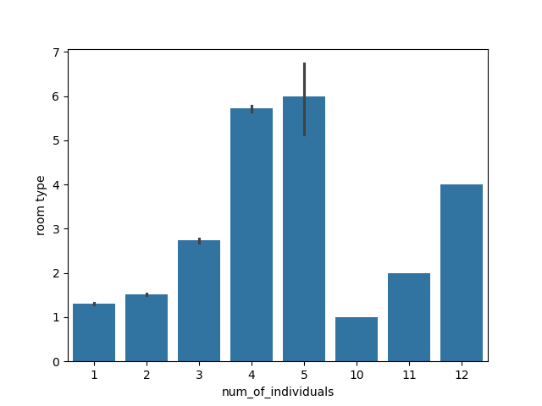
Number of Individuals and Room Type
This bar plot shows that the number of individuals and the room type also has a direct relationship.
This makes sense as the average price has a direct relationship with these 2 features.

Slide 11
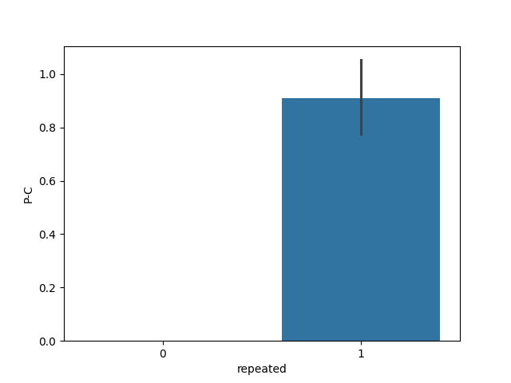
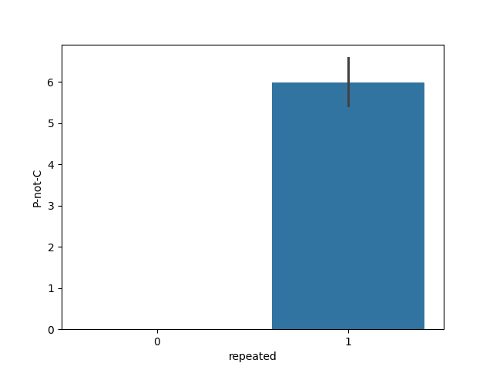
Repeated Customers relationships

Slide 12
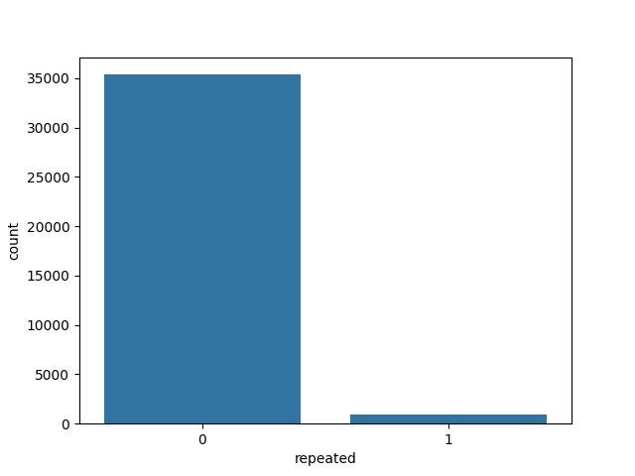
Repeated Customers
The previous slide showed that repeated customers are the ones that tend to either make a reservation then cancel or make a reservation and not cancel.
This count plot also shows that repeated customers are the minority class, whereas most customers haven’t visited the hotel previously.

Slide 13
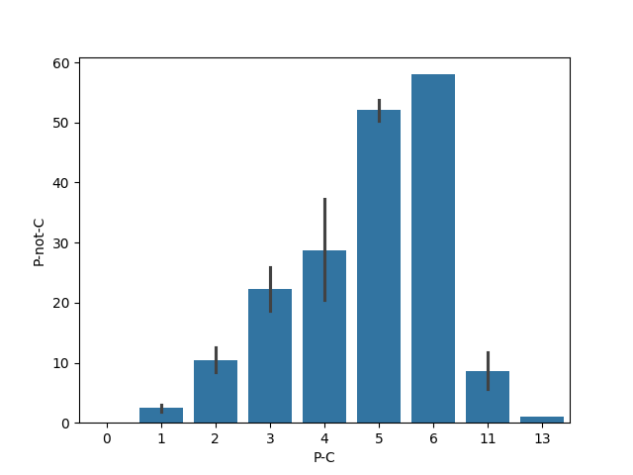
Previously Cancelled and Previously not Cancelled Relationship
This bar plot shows that there’s a direct relationship between the number of types a reservation was previously cancelled, and the number of times it wasn’t cancelled.
However, there’s a noticeable difference in the ratio between them, as the number of not cancelled previously is much higher than the cancelled preciously data points.

Slide 14
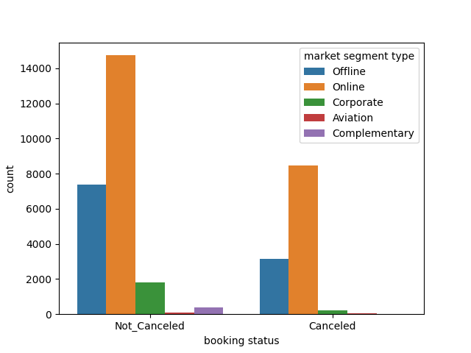
Market Segment and Label Relationship
This count plot shows that online reservations are the most likely to get either cancelled or not cancelled.
It is also shown that the aviation market segment is the least occurring in both cases

